Slide 1
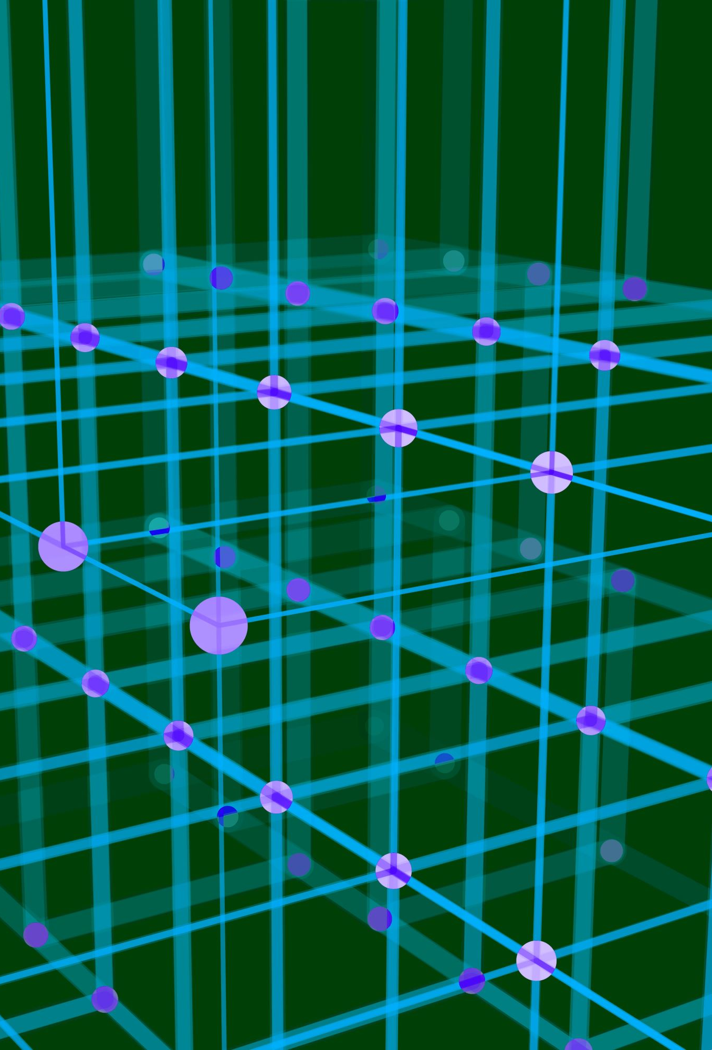
Data structure

Slide 2
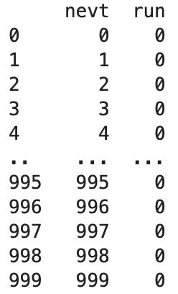

100x
Each file contains

Slide 3
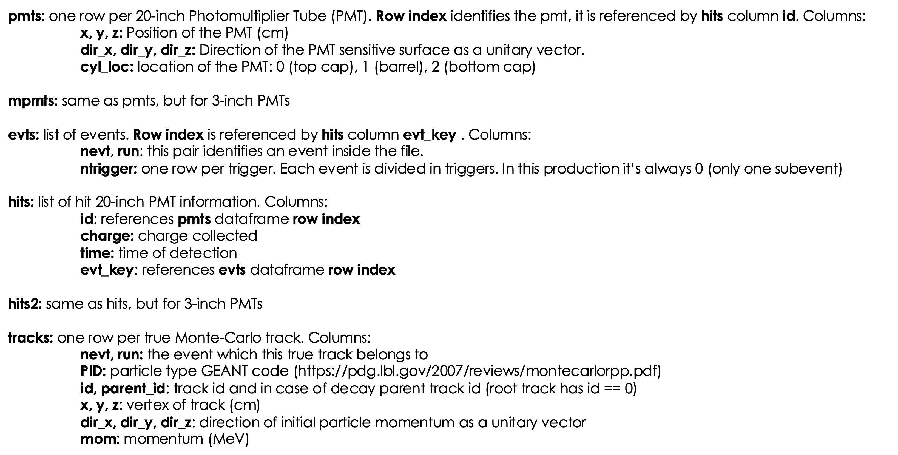
Each event contains:

Slide 4
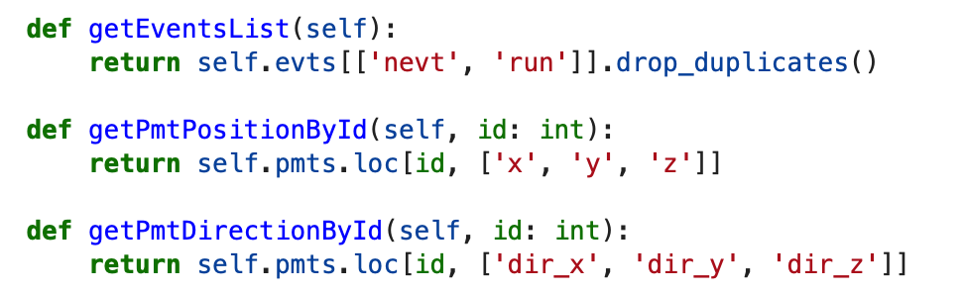
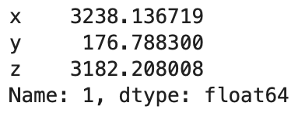
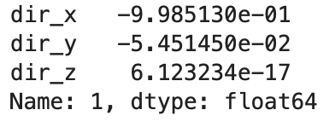
In detail – PMT Pandas DF Structure:

Slide 5
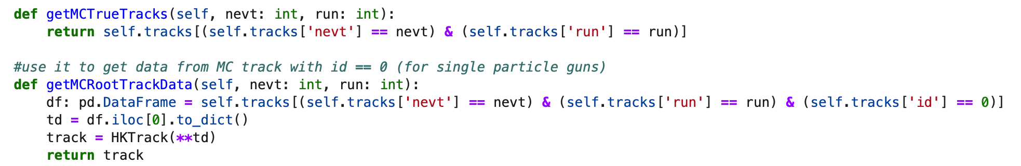
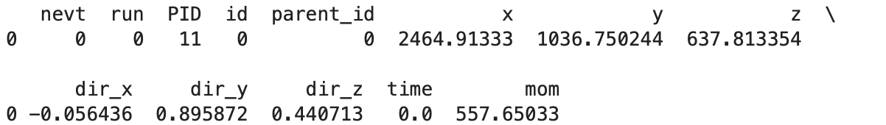
1
2
1
2
In this case, they are the same because the simulated events involve electron interactions. However, if we had a muon interaction instead, the root track would correspond to the muon, while the remaining tracks would represent the electrons and neutrinos produced from the muon decay

Slide 6
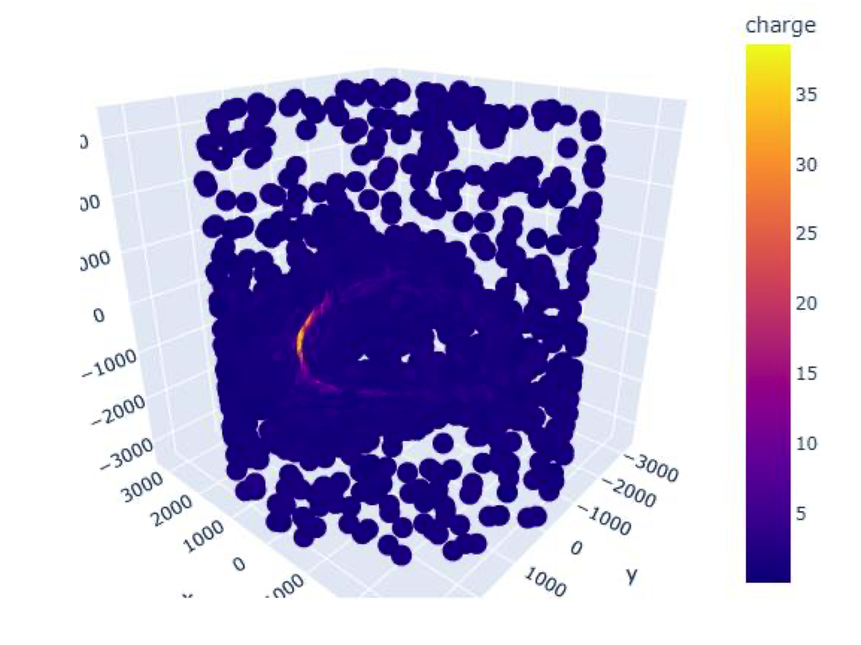
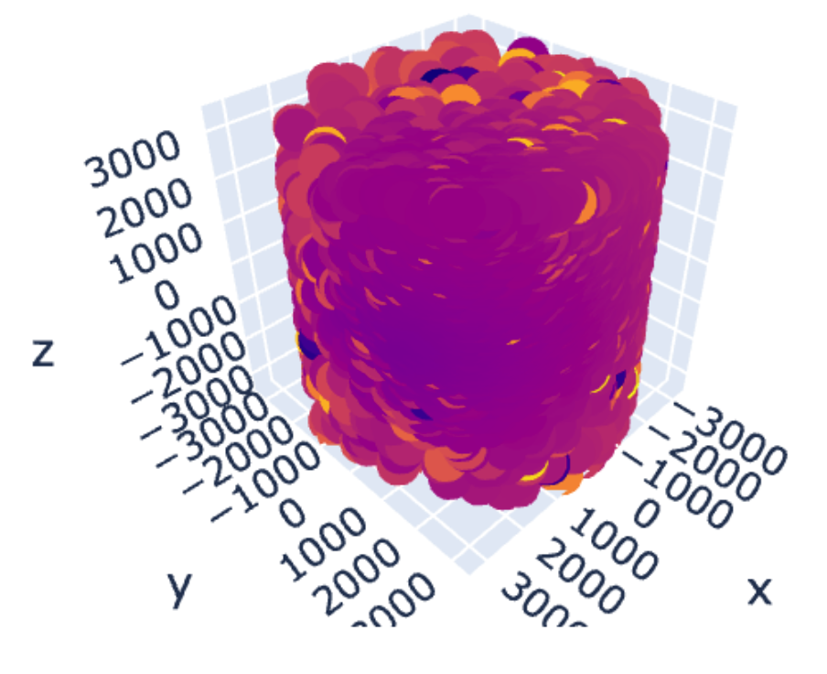
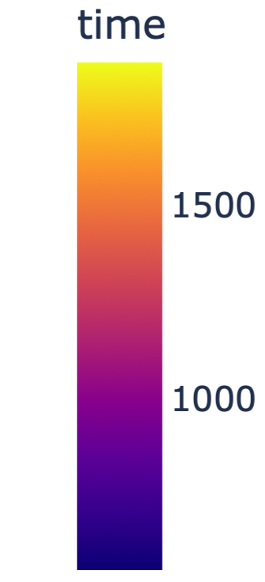
Event Display
Same structure for MPmts

